Slide 1
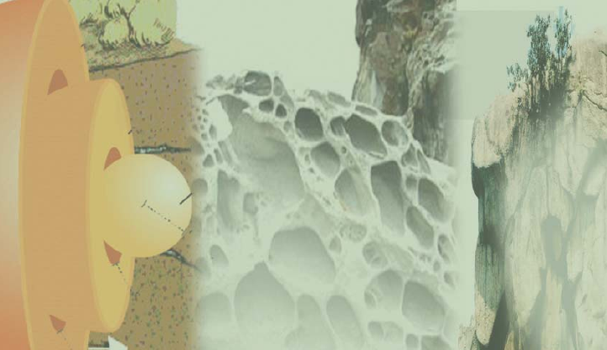


Slide 2
PLAY VIDEO

Slide 3
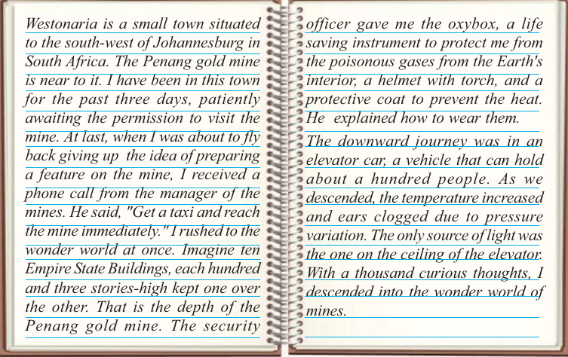

Slide 4
VIDEO

Slide 5
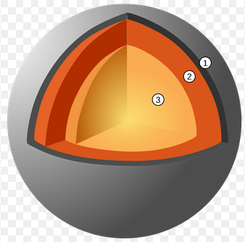

Slide 6
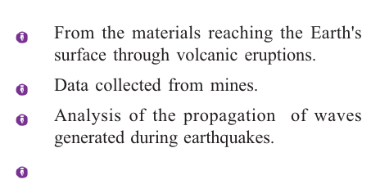
Informations from Earth’s Interior

Slide 7
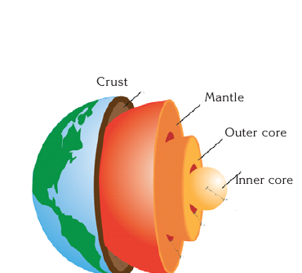
LAYERS OF THE EARTH

Slide 8
VIDEO

Slide 9
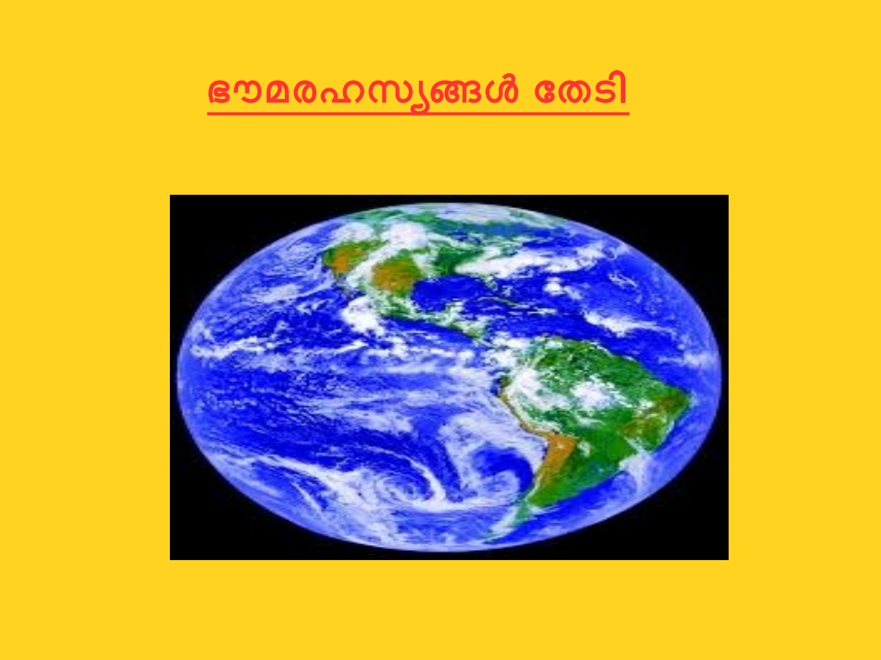


Slide 10
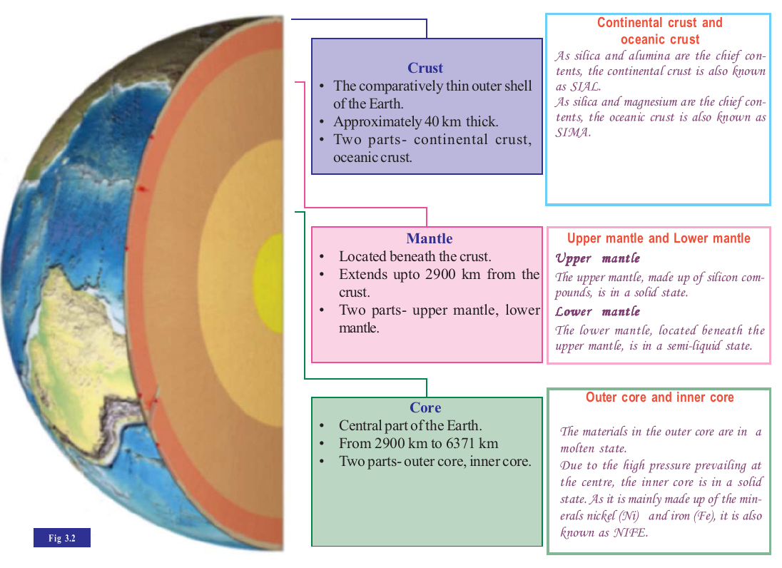

Slide 11
VIDEO

Slide 12
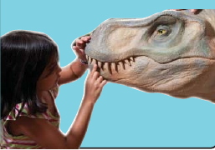
FOSSILS

Slide 13
Lithosphere-The crust and the upper part of the mantle together
Asthanosphere-The part beneath the lithosphere,where the materials exists in a partially molten state.

